Slide 1


Blockchain Lesson 6
Hardhat Simple Storage

Slide 2


Hardhat
Hardhat is a development environment for Ethereum software. It consists of different components for editing, compiling, debugging and deploying your smart contracts and dApps, all of which work together to create a complete development environment.

Slide 3
Installing
Hardhat is used through a local installation in your project. This way your environment will be reproducible, and you will avoid future version conflicts.
To install it, you need to create an npm project by going to an empty folder, running npm init, and following its instructions. You can use another package manager, like yarn, but we recommend you use npm 7 or later, as it makes installing Hardhat plugins simpler.

Slide 4
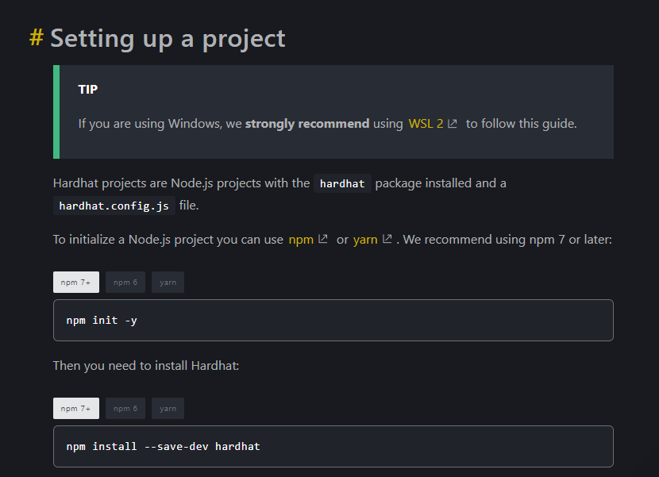
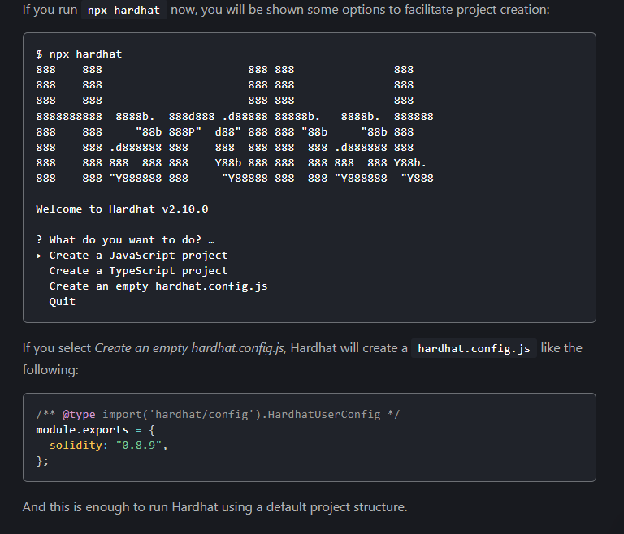
SETTING PROJECT HARDHAT

Slide 5
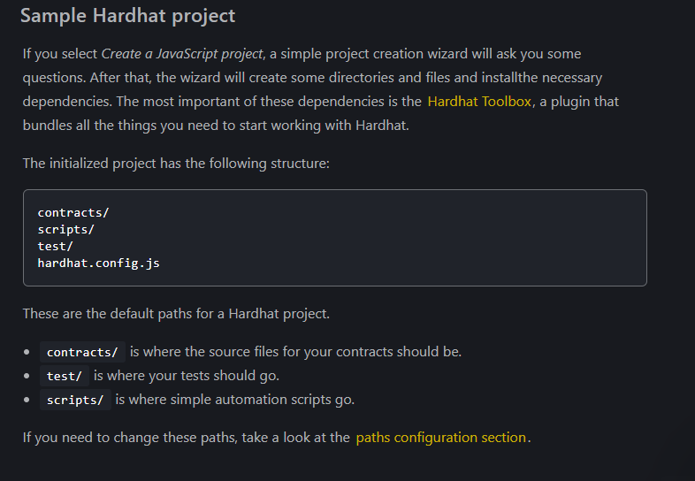
SIMPLE HARDHAT PROJECT

Slide 6
#Testing
When it comes to testing your contracts, the sample project comes with some useful functionality:
The built-in Hardhat Network as the development network to test on, along with the Hardhat Network Helpers library to manipulate this network.
Mocha as the test runner, Chai as the assertion library, and the Hardhat Chai Matchers to extend Chai with contracts-related functionality.
The
ethers.js
library to interact with the network and with contracts.
As well as other useful plugins. You can learn more about this in the Testing contracts guide.
#External networks
If you need to use an external network, like an Ethereum testnet, mainnet or some other specific node software, you can set it up using the networks configuration entries in the exported object in hardhat.config.js, which is how Hardhat projects manage settings.
You can use of the --network CLI parameter to quickly change the network.
Take a look at the networks configuration section to learn more about setting up different networks.

Slide 7
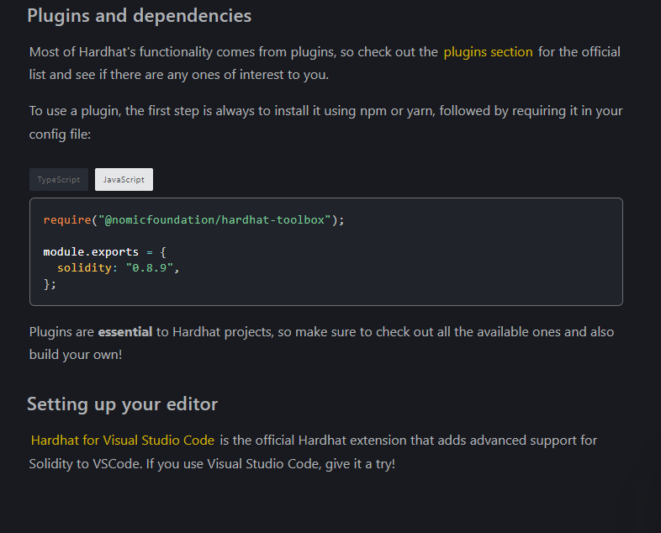

Slide 8
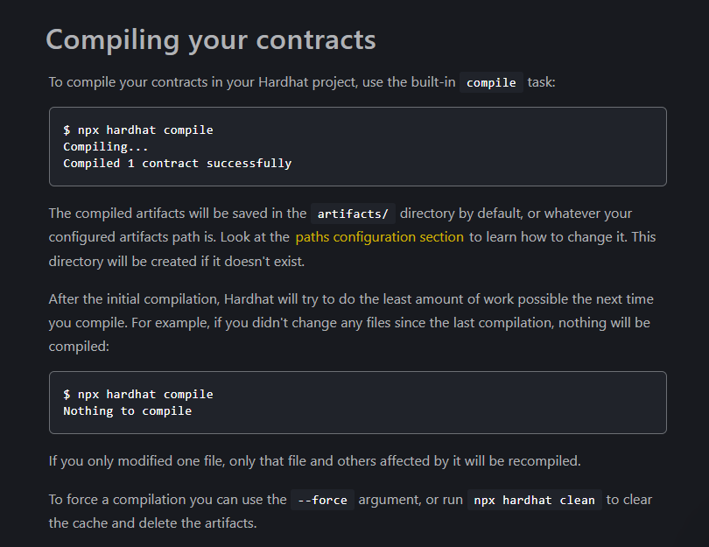

Slide 9
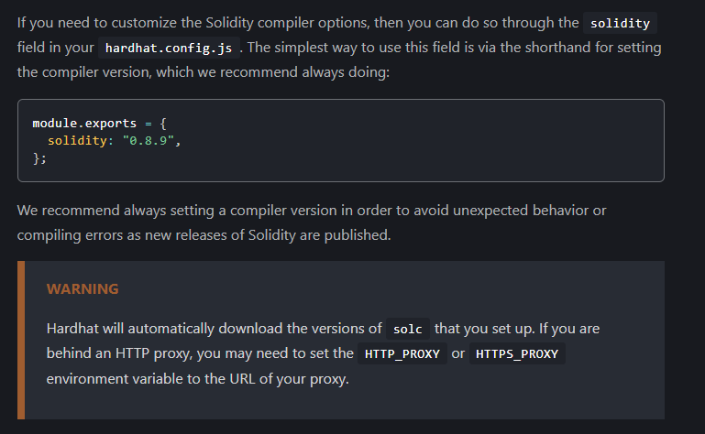
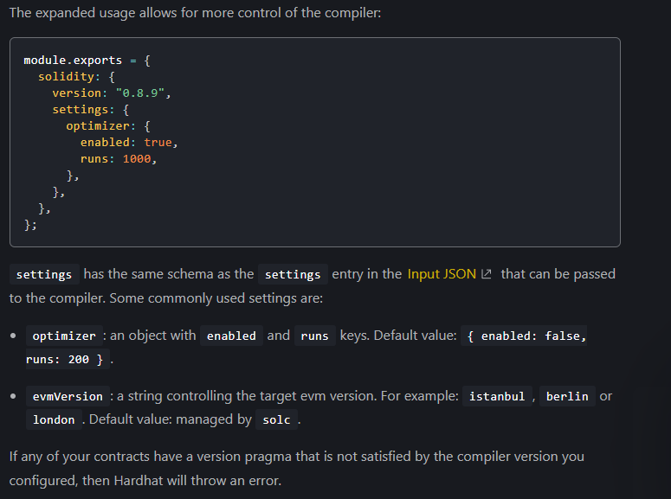
CONFIGURING COMPILER

